Slide 1




LAPTOP PRICE PREDICTOR

Slide 2



Team
RITESH R SHETTY
4NM20IS136
SHAUN NORONHA
4NM20IS132
6-C ISE

Slide 3






Agenda
01
Introduction
02
Motivation
03
Problem Statement
04
Methodologies
05
Conclusion

Slide 4

Introduction
With the rise of e-commerce, customers are constantly searching for the best deals and prices on the products they intend to buy. However, with so many websites offering the same product, it can be time-consuming and tedious for customers to compare prices across different websites.
The online laptop price predictor is a web-based machine learning tool that enables users to predict the prices of laptops based on various features such as the processor, memory, screen size, and brand. This tool offers a user-friendly interface that allows users to input the desired features and obtain an estimated price for a laptop.
With the ability to predict laptop prices accurately, online retailers can optimize their pricing strategies and offer customers competitive prices.

Slide 5


Motivation​
In the world of e-commerce, prices of products can fluctuate rapidly due to various factors such as competition, demand, supply, and market trends. For businesses, keeping track of these price changes is essential to remain competitive and to ensure profitability. This is where price trackers come into play.
The topic of "price tracker" is highly relevant in today's e-commerce landscape. It can help businesses to stay competitive by monitoring the prices of their products as well as those of their competitors, and provide valuable insights into market trends and consumer behavior that can inform pricing and marketing strategies.
Price trackers can provide businesses with valuable insights into market trends, consumer behavior, and pricing strategies of their competitors, which can help them make informed decisions about their own pricing strategy. By using a price tracker, businesses can stay competitive and adjust their pricing strategies quickly to capitalize on opportunities and maintain profitability.

Slide 6



Problem Statement​
The problem addressed by a price predictor is how to monitor and adjust pricing strategies in the e-commerce market to stay competitive and maximize profits.

Slide 7


Objectives
Accurately track the prices of products:
The primary objective of a real-time product price tracker is to provide accurate and up-to-date pricing information for products.
✓
Identify pricing trends:
The price tracker should help businesses identify pricing trends over time, such as seasonal fluctuations or changes in demand.
✓
Alert users to price changes:
The price tracker should help businesses identify pricing trends over time, such as seasonal fluctuations or changes in demand.
✓
Provide historical pricing data:
The tracker should store pricing data over time, so users can analyze past pricing trends and make informed decisions.
✓

Slide 8




Objectives
Customization:
The tool should allow users to customize their tracking preferences, such as setting price thresholds or selecting specific products or categories to track.
✓
Integrate with e-commerce platforms:
The tool should integrate with popular e-commerce platforms, such as Amazon or Flipkart, to make it easier for businesses to track product prices across multiple channels.
✓

Slide 9
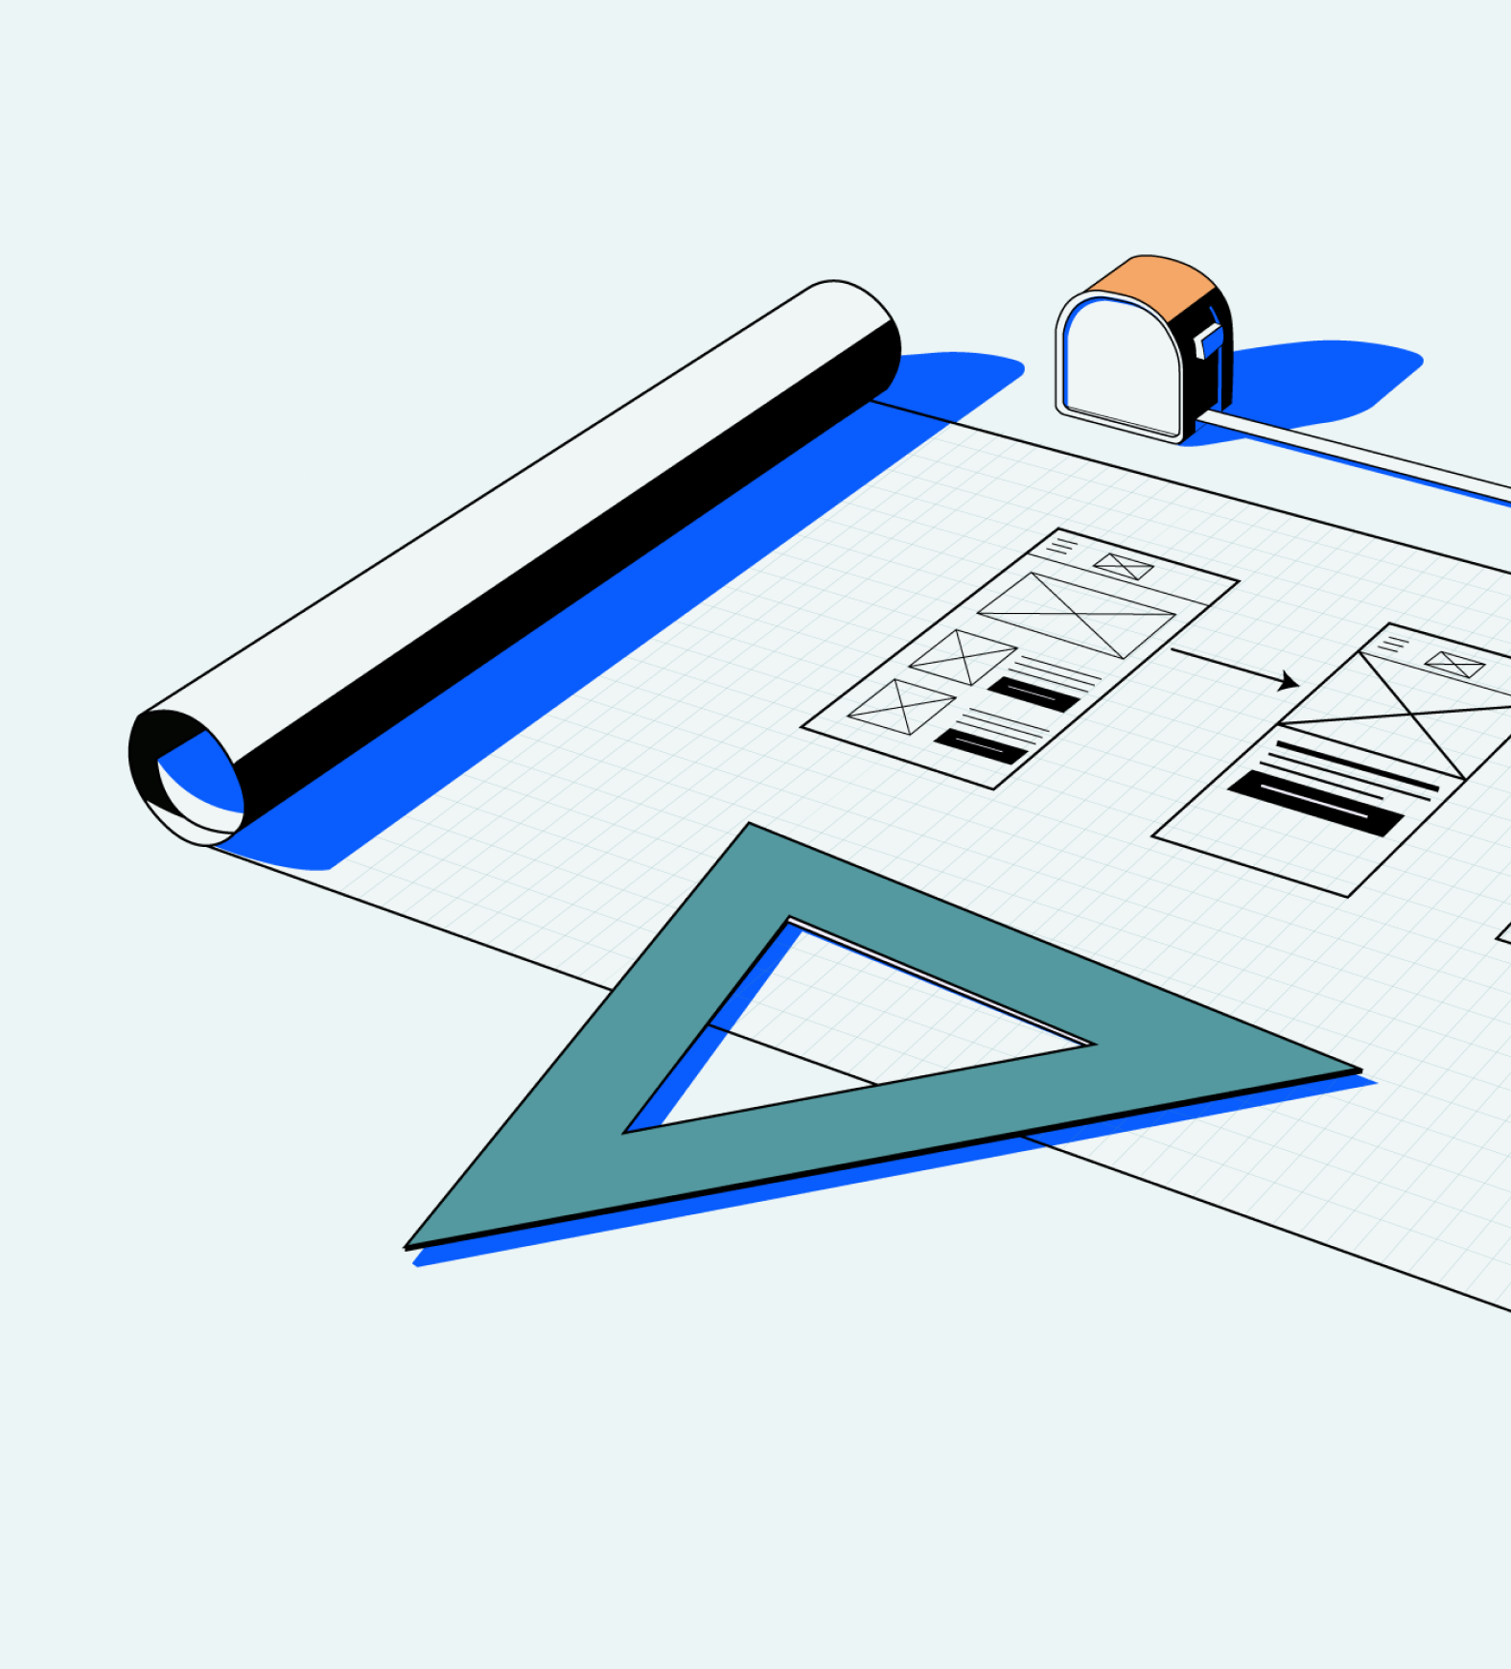
Methodology
1. Web scraping:
This involves using software to extract pricing data from e-commerce websites, manufacturer websites, and other online sources.
2. API integration:
Many e-commerce websites and other online retailers offer APIs that allow third-party developers to access pricing and product information.
3. Data feeds:
Some e-commerce websites offer product and pricing data feeds that can be used to build a price tracker.
4. Machine learning:
Machine learning algorithms can be used to analyze historical pricing data and make predictions about future price trends.
5. Crowdsourcing:
A price tracker can be built by crowdsourcing pricing data from users.

Slide 10

Literature Survey​
"Price Tracking in E-commerce: A Literature Review" is a research paper published in 2021 by K. Wang, J. Su, X. Zhang, and Y. Shi. The paper provides a comprehensive literature review of the current state-of-the-art research on price tracking in e-commerce.
The paper begins with an introduction to the importance of price tracking in e-commerce and the challenges faced by businesses in this area. It then provides an overview of the different methods used for price tracking, such as web scraping, data mining, and machine learning.The authors examine the impact of e-commerce platforms and online marketplaces on pricing, as well as the emergence of new technologies such as blockchain and artificial intelligence
Finally, the paper concludes with a discussion of the future directions for research in price tracking and e-commerce. It identifies the need for further research in areas such as ethical considerations in price tracking, the impact of social media on pricing, and the development of new pricing models and strategies.

Slide 11

Literature Survey​
"Consumer Responses to Price Changes: An Integrative Review of the Literature" is a research paper published in 2018 by J. Du, L. Lu, and Z. Cao. The paper provides a comprehensive literature review of the research on consumer responses to price changes.
The paper begins with an overview of the importance of price in the consumer decision-making process and the impact of price changes on consumer behavior. It then explores the different factors that influence consumer responses to price changes, including individual factors, situational factors, and contextual factors.
The paper provides an in-depth analysis of the different types of consumer responses to price changes, including price acceptance, price rejection, and price search behavior. The authors explore the factors that influence each type of response and how businesses can use this information to develop effective pricing strategies.

Slide 12

Scope of the survey:
Price tracking:
This would involve an overview of the different methods and techniques used to track prices, such as web scraping, data mining, and machine learning.
Pricing strategies:
This would include an examination of the different pricing strategies used by businesses, such as dynamic pricing, value-based pricing, and cost-plus pricing.
Pricing trends:
This would involve a review of current pricing trends and changes in the market, such as the impact of e-commerce and online marketplaces on pricing.
Case studies:
This would include an examination of case studies and examples of successful price tracking and pricing strategies used by businesses in various industries.

Slide 13
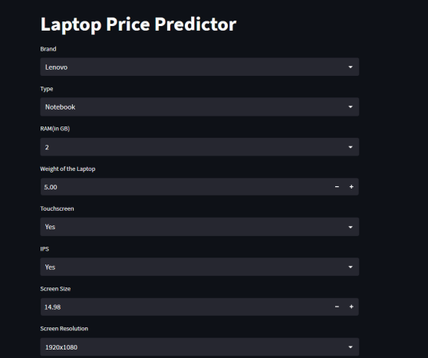
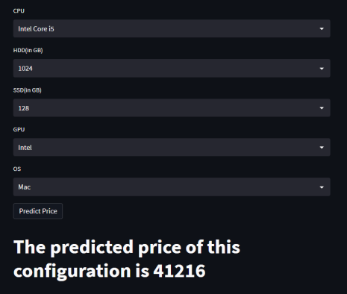
DIAGRAMS:​

Slide 14

CONCLUSION
In conclusion, the laptop price predictor is a valuable machine-learning tool that can help consumers and manufacturers in making informed decisions regarding laptop purchases and pricing strategies. By utilizing a vast dataset of laptop features and prices, the model can learn the relationships between the various features and predict the price of a laptop accurately.
In summary, the laptop price predictor is a powerful tool that can be enhanced further by incorporating additional data, algorithms, and user feedback, among other features. Continued development and refinement of the model can provide significant benefits to the technology industry, resulting in more informed purchasing decisions and competitive pricing strategies.

Slide 15
Thank you

